Slide 1
Lab 3: The IMU, The Gimbals, and the Motor
Due midnight, April 14th

Slide 2
Topics
Analog Inputs – How the microcontroller measure the position of the gimbals
Brushed Motors – How they work and how to drive them.
I2C – How the microcontroller and IMU communicate

Slide 3
I2C

Slide 4
Inter-Integrated Circuit (I²C) Bus Interface AKA: Two Wire Interface (TWI)

Slide 5
Brief History
Designed in 1982 by Philips Semiconductor (now NXP)
1992 - First public Spec released
Since 2006 no licensing fees are required
Widely adopted technology

Slide 6
Why I²C?
Pins are precious!
They take up space
More pins → More expensive microcontrollers
Adding pins is hard
Might need a new microcontroller (if a larger, compatible one is available)
Significant board changes
Performance is often not that important
So
Use the minimum number of pins
Run them at relatively low bit rates.

Slide 7
Applications
Connecting to all kinds of small, slow peripherals
Reading Configuration data from various devices (Memory, PCI cards)
Accessing ADCs and DACs
Reading from Real-time clocks
Reading hardware monitoring devices (Fan speed, CPU Temperature, Accelerometers)
Controlling power supplies for various system components
GPIO expanders
Many, many others

Slide 8
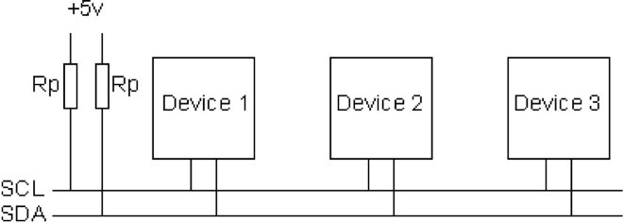
I²C Bus Architecture
Two signals
SCL – Serial Clock (used for coordination and timing)
SDA – Serial Data (used for data and control signaling)
Up to 1008 peripherals
1 or more “masters” that initiate communication on the bus
Up to 127 “slaves” that masters communicate
Bit rates
100 KHz (Standard mode)
400 KHz (Fast Mode)
3.4 MHz (High speed mode)
1 MHz (Fast Mode Plus)
5 MHz (Ultra fast mode)

Slide 9
I²C Addressing
Each slave on an I²C bus has a unique address.
Most use 7 bit addresses (we discuss this here)
An extended 10-bit version also exists
The addresses usually fixed or only partially configurable
E.g. Only the least-significant bit of the address for the IMU is settable. So you can only have two of these IMUs on one bus.
Different devices will have different numbers of settable and fixed bits.
You can’t mix components arbitrarily on the bus

Slide 10
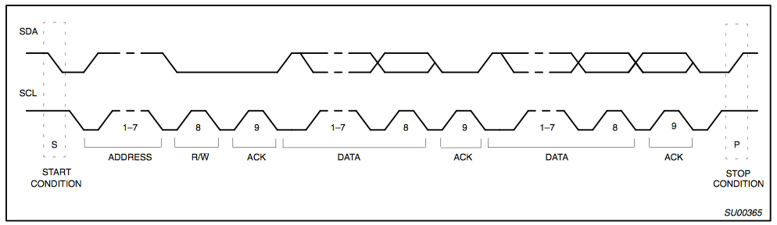
I2C Protocol - Full Xfer
Start
Philips I2C Bus Specification

Slide 11
I2C Protocol - Full Xfer
Address
R/W
Philips I2C Bus Specification

Slide 12
I2C Protocol - Full Xfer
Data
Philips I2C Bus Specification

Slide 13
I2C Protocol - Full Xfer
Stop
Philips I2C Bus Specification

Slide 14
Gimbals

Slide 15
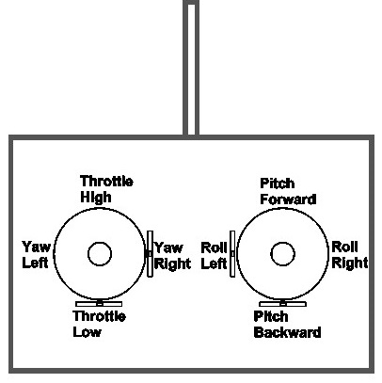
Controlling the Quadcopter
Standard RC “transmitters” have two sticks
Left: throttle and yaw
Right: pitch and roll
This is called “mode 2” It’s different in Europe where they use “mode 1”
Yaw, pitch, and roll are spring-loaded to return to neutral
Throttle stays where you put it.

Slide 16
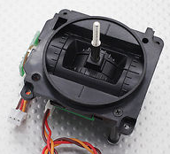
The Gimbals
Each stick is a “gimbal”
a mechanism, typically consisting of rings pivoted at right angles, for keeping an instrument such as a compass or chronometer horizontal in a moving vessel or aircraft. – The dictionary on my Mac

Slide 17
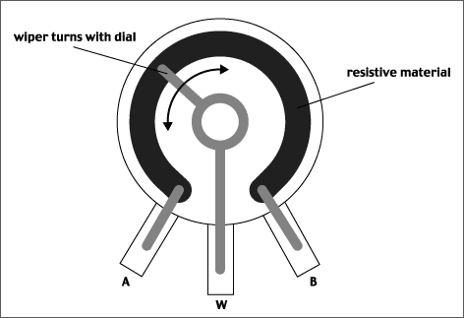
Anatomy of a Gimbal
Two potentiometers measure X and Y movement of the stick.
Potentiometer – A variable voltage divider
As the slider moves, the resistances between A and W and W and B change.
If A is at Vcc and B is at GND, then the voltage at W is proportional to the position of the gimbal.

Slide 18
Brushed DC Motors

Slide 19
Brushed Motors

Slide 20
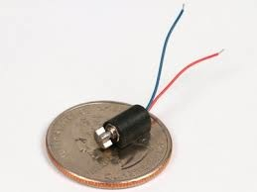
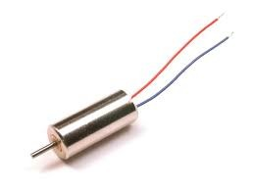
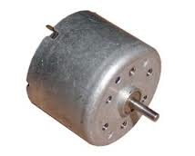
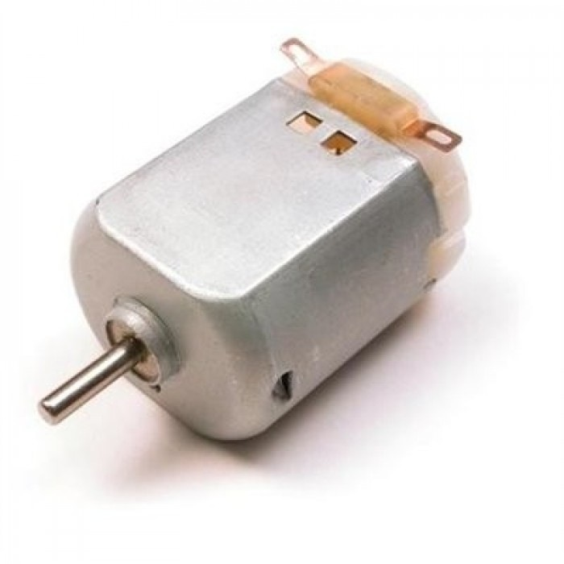
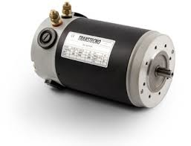
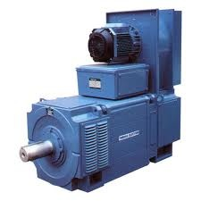
Brushed Motors

Slide 21
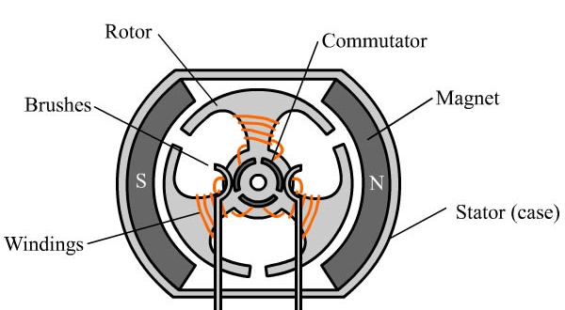
Construction

Slide 22
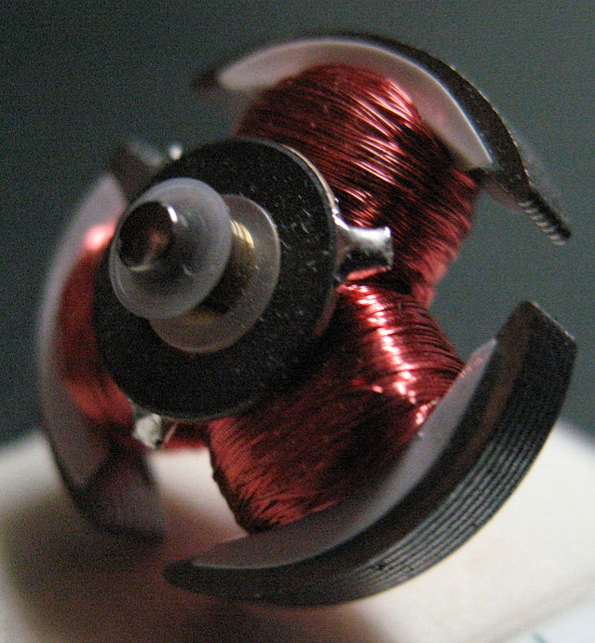
Construction (Rotor)

Slide 23
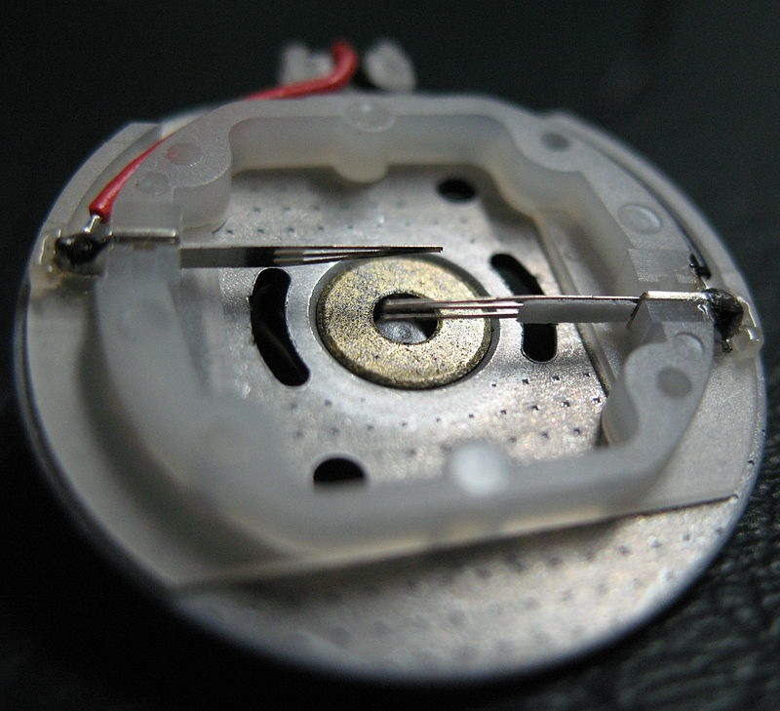
Construction (Stator)

Slide 24
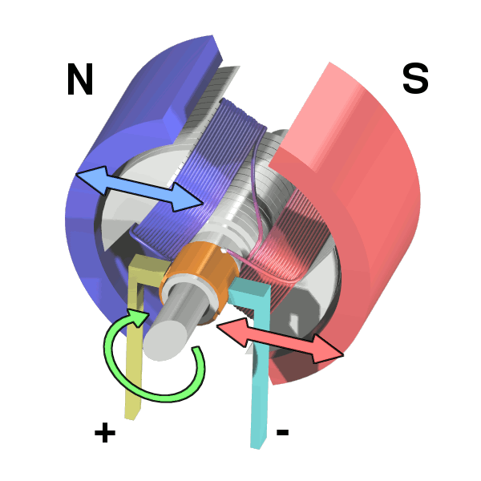
Operation

Slide 25
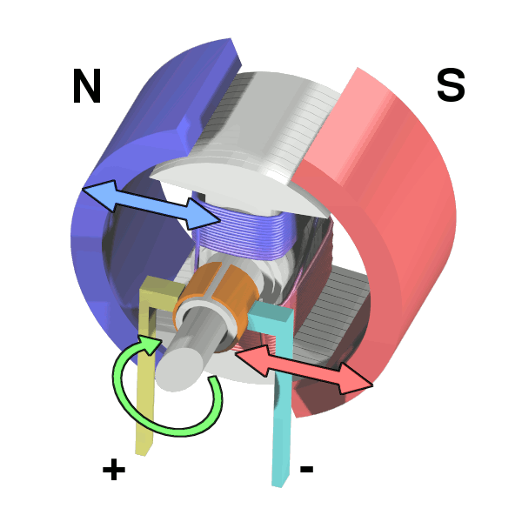
Operation

Slide 26
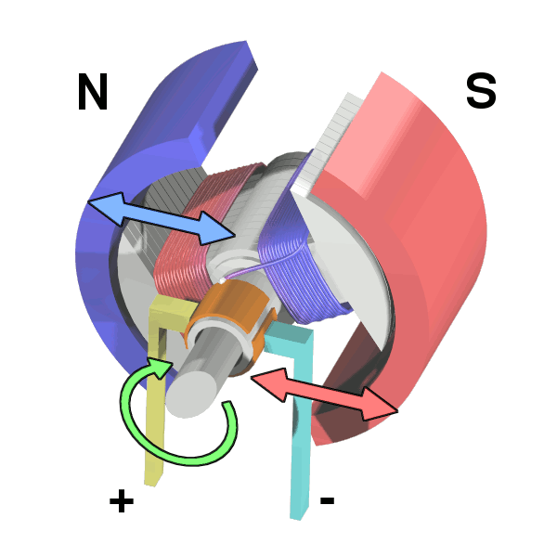
Operation

Slide 27
Operation

Slide 28
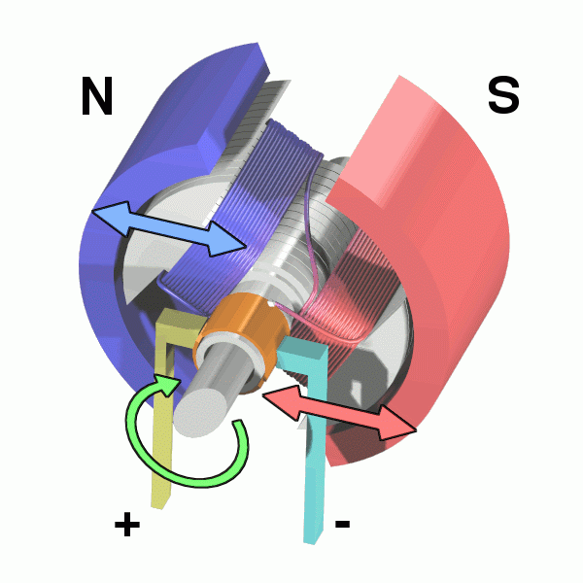
Operation

Slide 29
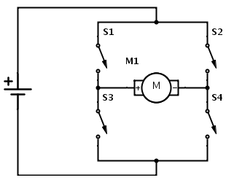
H-Bridge

Slide 30
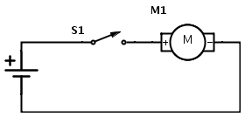
Flyback
When S1 is open after the motor has been running, M1 becomes a big inductor
It will drive up the voltage on GND
Potentially damaging/interfering with other parts of the circuit
This is called “fly back”

Slide 31
Flyback

Slide 32
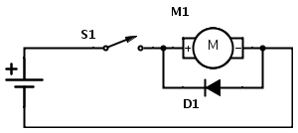
Flyback Diode
Adding a diode, allows the current to loop around through the motor and eventually dissipate

Slide 33
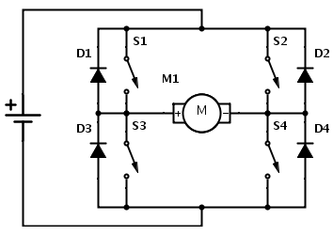
H-Bridge

Slide 34
Control
How would you control your motor’s speed?

Slide 35
Control
How would you control your motor’s speed?
Speed ∝Voltage ∝Current
So, vary the input voltage
Generating varying voltages is non-trivial
You need an digital-to-analog converter
Really, we just need the average voltage to vary

Slide 36
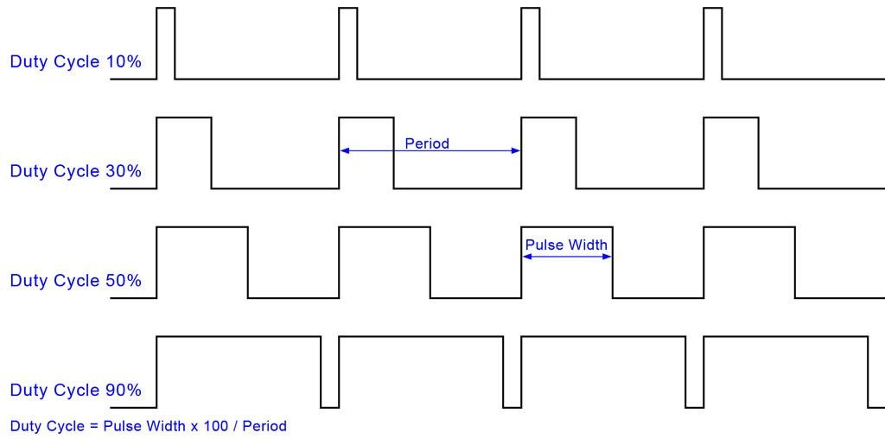
Pulse-width Modulation (PWM)

Slide 37
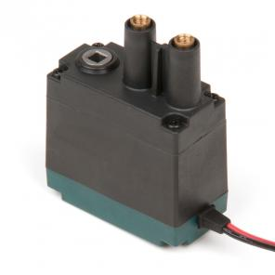
Selection
Free Speed:100 rpm
Stall Torque:8.6 in-lbs
Stall Current:2.6A
Free Current:0.18A
Specifications at 7.2V

Slide 38
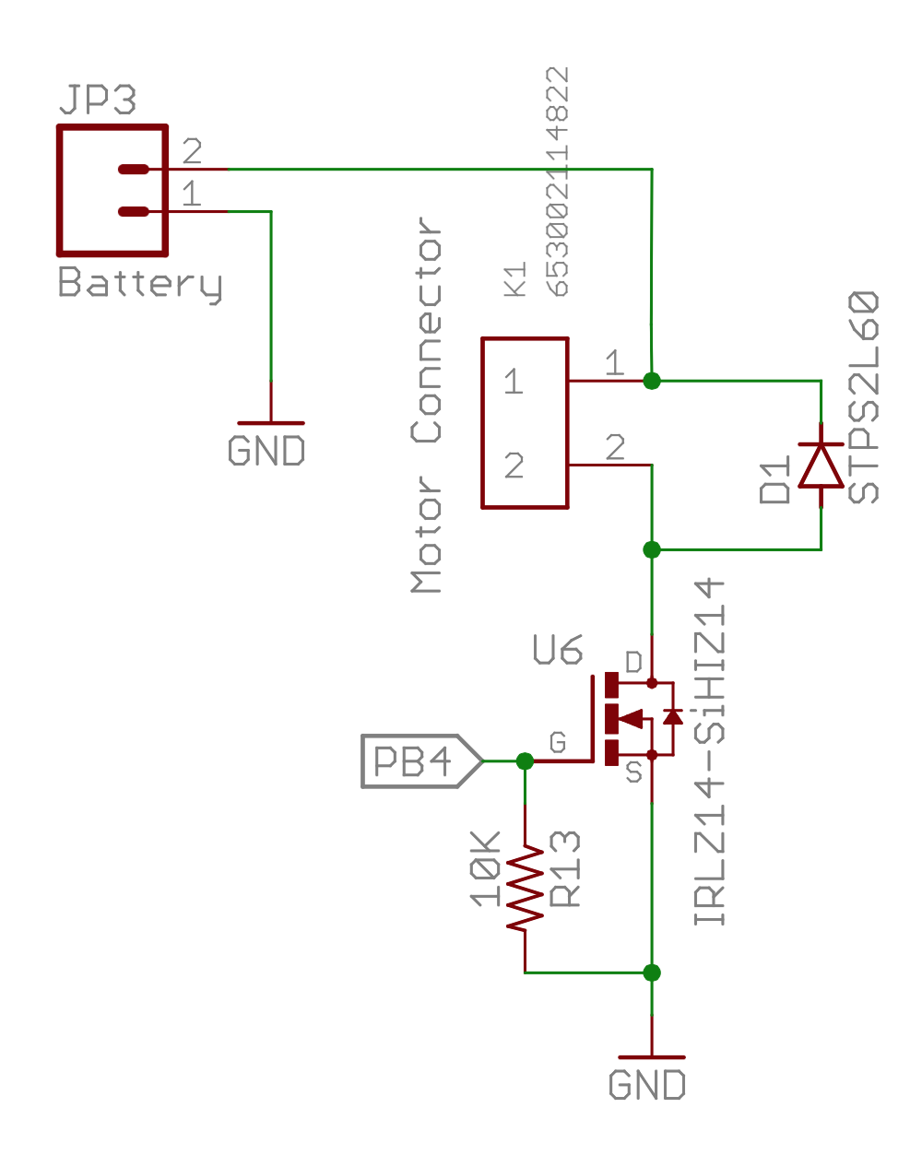
Our Motor Circuits

Slide 39
Analog IO in Arduino
The red board board has several analog pins
analogRead()
Takes a voltage between GND and Vcc and maps it to 0—1024
analogWrite ()
Takes a value, x, between 0 (off) and 255 (on) and sets the duty cycle to x/255.

Slide 40
Lab 3 Teams
Tanima Shukla and Andranik Kulikyan
David Smith and Li, Dejun
Ryan Collins and Smith, Trevor Alan
Spotkaeff, Kirt Kamawaipolani and James Lee
Knapp, Daniel Alan and Matt Asaro

